Slide 1

Research Abroad Opportunities

Slide 2
Research Abroad Opportunities Table of Contents
Structured Research Abroad Options:
GlobalLinks: EuroScholars program
Research add-on to a study abroad program
Arcadia University: STEM Summer Research Program
DAAD (RISE): Research Internships in Science and Engineering
NSF – REU
Unstructured Research Abroad Options
Faculty Contacts
Independent Research
Student Testimonials

Slide 3
GlobalLinks: EuroScholars
GlobalLinks: EuroScholars
Semester or year-long options in multiple countries
Students choose more or less research-intensive semester
Can choose from the many listed projects, or create their own
Sponsored by the Office of Education Abroad
Study Abroad Structure
Students work with the Office of Education Abroad
Students pay CWRU tuition (Keeping your financial aid!); housing and meals to the overseas institution
Do not need knowledge of a second language
Students earn CWRU credits, using the Course Approval Form

Slide 4
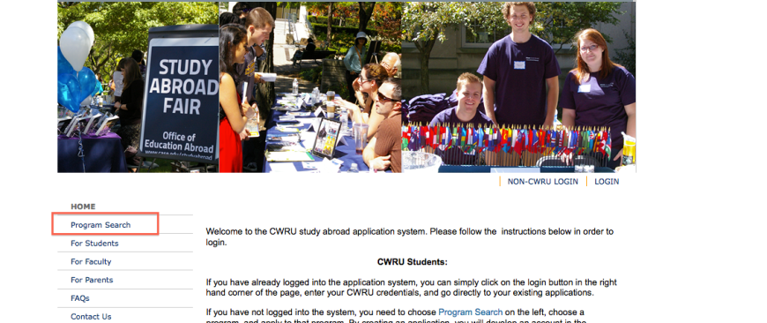
GlobalLinks: EuroScholars From http://studyabroad.case.edu, click on Program Search

Slide 5
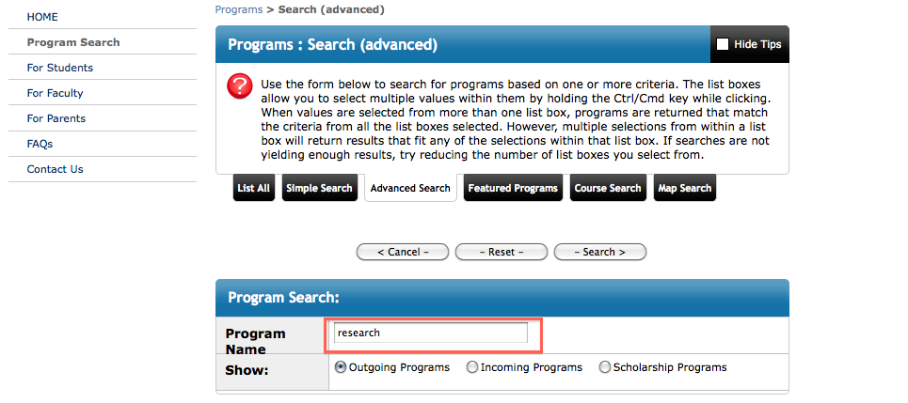
GlobalLinks: EuroScholars In the search engine, type in research

Slide 6
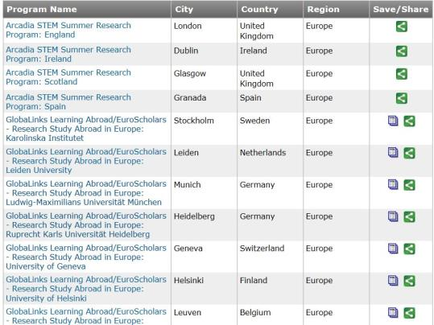
GlobaLinks: EuroScholars A list of options will appear, select a “GlobaLinks” one

Slide 7
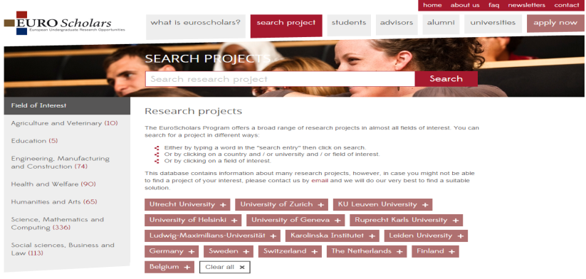
GlobalLinks: EuroScholars Select an Institution or Field of Interest

Slide 8
Research Add-on to a Study Abroad Complete research as part of study abroad!
Many different opportunities available via the Program Search engine
Semester or summer options in multiple countries
Students choose institution and location based on research projects available
Sponsored by the Office of Education Abroad
Study Abroad Structure
Students work with the Office of Education Abroad
Students earn CWRU credits, using the Course Approval Form
Do not need knowledge of a second language
Finances
Semester programs: students pay tuition to CWRU and housing, meals, and any fees overseas
Summer programs: students pay everything overseas (tuition, housing, fees, etc.)

Slide 9
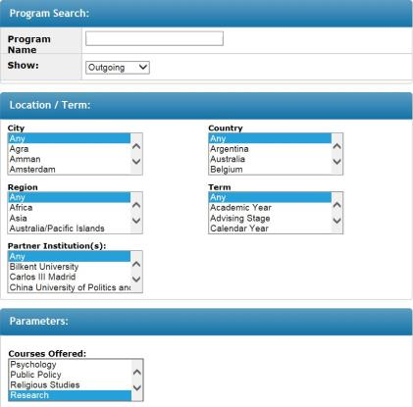
Research Add-on to a Study Abroad In the “courses offered” box, select research
Then, click “Search” back at the top of the page…

Slide 10
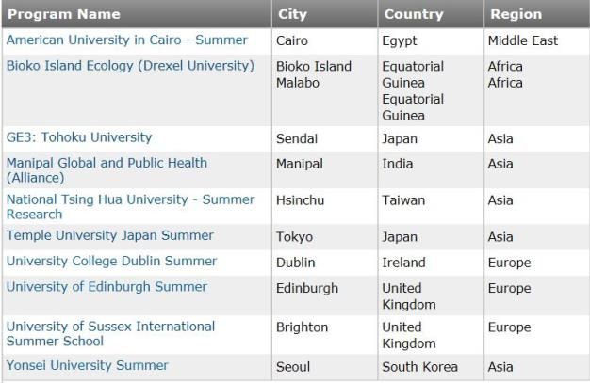
Research Add-on to a Study Abroad Select the program that interests you!
After you click on the program, the “Click to Visit” button provides even more information and the homepage of the program itself!

Slide 11
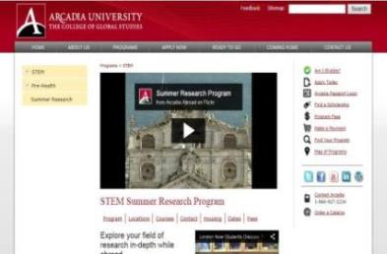
Arcadia University: STEM Summer Research Program
Arcadia offers 4 STEM summer research programs
Application deadline is February 1st!
Biomedical Sciences
Royal Veterinary College: London
6 weeks, 6 research credits
Environmental Sciences, Physics & Math
CEAMA: Granada, Spain
8 weeks, 10 credits: 6 research, 4 language

Slide 12
Arcadia University: STEM Summer Research Program
Programs range from $6,500 - $10,000 including tuition, housing, and orientation
Scholarships are available for $250 – $1,000 from Arcadia
Additional scholarships available on the CWRU website
Math/Statistics, Biology, Chemistry & Physics
The University of Glasgow: Scotland
6 weeks, 6 research credits
Biology, Chemistry, Computer Science, Math, Geological Sciences, Math & Physics
University of College Dublin (UCD): Dublin, Ireland
8 weeks, 6 research credits
Deadline is February 1st: Apply soon!
https://studyabroad.case.edu

Slide 13
DAAD - RISE: Research Internships in Science and Engineering https://www.daad.de/rise/en/
RISE is a summer internship/research program for undergraduate students in biology, chemistry, physics, earth sciences and engineering.
Work with research groups and top research institutions across Germany
For a period of 2 to 3 months, over the summer
RISE interns are matched with doctoral students whom they assist and who serve as their mentors.
The working language will be English.
All scholarship holders receive stipends from the DAAD to help cover living expenses
Partner universities & research institutes provide housing assistance
The database for students is open from December to January, and students must register on the database in order to be able to apply to PhD student projects (up to 3)
Applications are due by January 15th 2016

Slide 14
NSF – REU: National Science Foundation – Research Experiences for Undergraduates
The National Science Foundation – Research Experiences for Undergraduates (NSF-REU) are summer research programs sponsored by Universities across the country.
The research programs are typically 8-10 weeks in length.
With some exceptions, the international research programs are mostly in the sciences and engineering.
The programs typically cover international travel expenses, cost of room and board, and a stipend.
The NSF-REU site can be found at: http://www.nsf.gov/crssprgm/reu/reu_search.jsp

Slide 15
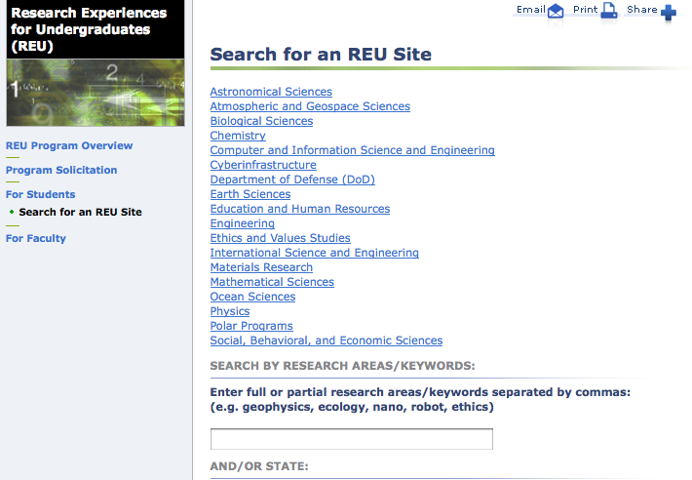
NSF – REU From there choose the link below: “International Science and Engineering

Slide 16
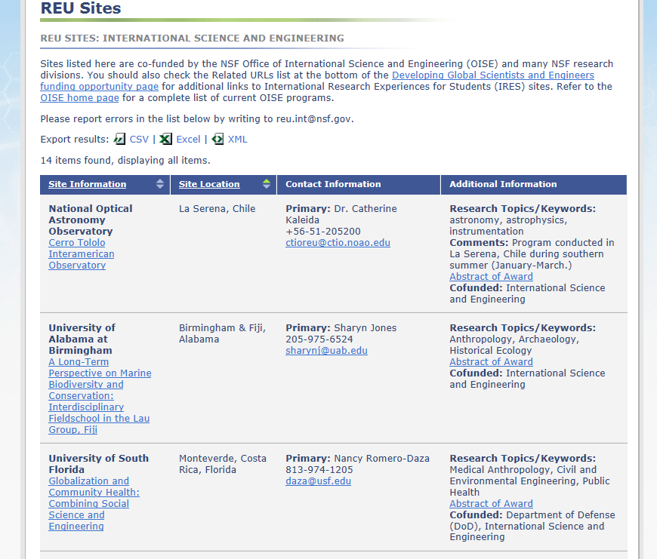
NSF – REU Once you click on a field of research, different opportunities and contact information are provided

Slide 17
Faculty Contacts
Students often use the faculty within their field to find out about research opportunities, as well.
This is more self-driven, but SOURCE and the Office of Education Abroad can help formalize the process by:
Directing students to financial resources (SOURCE)
Providing emergency and medical insurance, and managing the risks (Education Abroad)
All faculty at CWRU are involved in research, and a lot of that is abroad. Stop by during office hours to see what your advisor or professor is doing!

Slide 18
Independent Research
Students sometimes find research abroad opportunities through other means: their own networking and contacts, online, previous work or intern experience, etc.
This is again more self-driven and SOURCE and the Office of Education Abroad can formalize and help support these endeavors.
Note that if you do find research abroad opportunities online or through even a somewhat distant contact, you should carefully review their work and reviews. We can help you ascertain this, too!

Slide 19
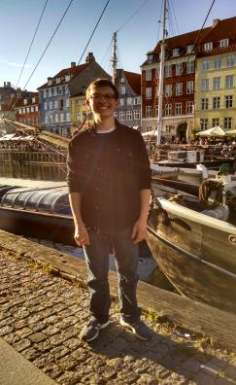
Student Testimonial
Eric Bruckner is a Junior majoring in Polymer Science and Engineering and he studied abroad at the University of Hamburg.
Eric Bruckner helped to develop an electrospinning process to create crosslinked polymer nanofibers with stable morphology. He also synthesized UV and thermally responsive polymers, based on spiropyran and polyNiPAM, that can be electrospun into stimuli-responsive fibers.
He states, “My experience abroad taught me that the global research community is closely-knit despite its size. I was able to network with fellow students and researchers around the world, while living in a different culture.”

Slide 20
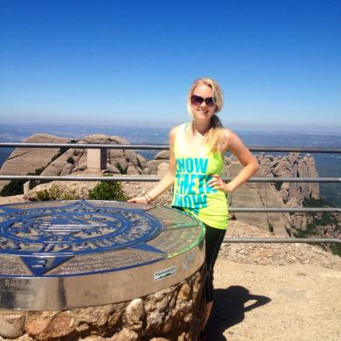
Student Testimonial
Katie Rose is a Junior majoring in Polymer Science and Engineering with a minor in Biomedical Engineering and Chemistry.
Along with another Case student, Katie mixed additives into PBS and PBS/PET systems to see the effect on flame retardancy. They measured those properties through DSC, TGA and cone calorimetry testing throughout the summer.
She states, “Researching abroad was an eye opening experience. I was pushed out of my comfort zone with my research and it allowed me to learn more about other cultures and traditions. I was able to travel to 11 different countries, meet people from all over the world, and I would go back in a heartbeat.”

Slide 21
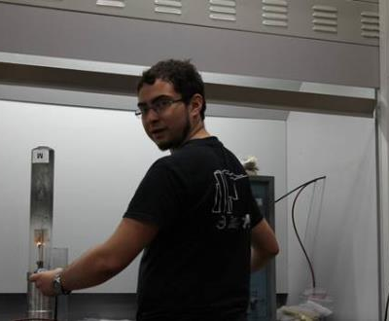
Student Testimonial
Daniel Watson is a Senior majoring in Polymer Science and Engineering. He conducted research at Sichuan University.
He worked with halogen-free flame retardation of polypropylene. His research team compared nine organically modified ammonium polyphosphate additives at varying concentrations.

Slide 22

Questions??

